Slide 1
Hydrological Information System
Module - ADCP Deployment
Anish
….. Hydro-Informatics Expert
The World Bank

Slide 2
Site Selection
Close attention should be paid to ensuring the measurement is being made at a suitable site.
If parts of the cross section are of unacceptable quality, the length of the tether may be adjusted in an attempt to find a more suitable cross section slightly farther up or downstream.
At some sites, it may not be possible to use a tethered platform to make an ADCP measurement because of the limited ability to change the measurement cross-section location.

Slide 3
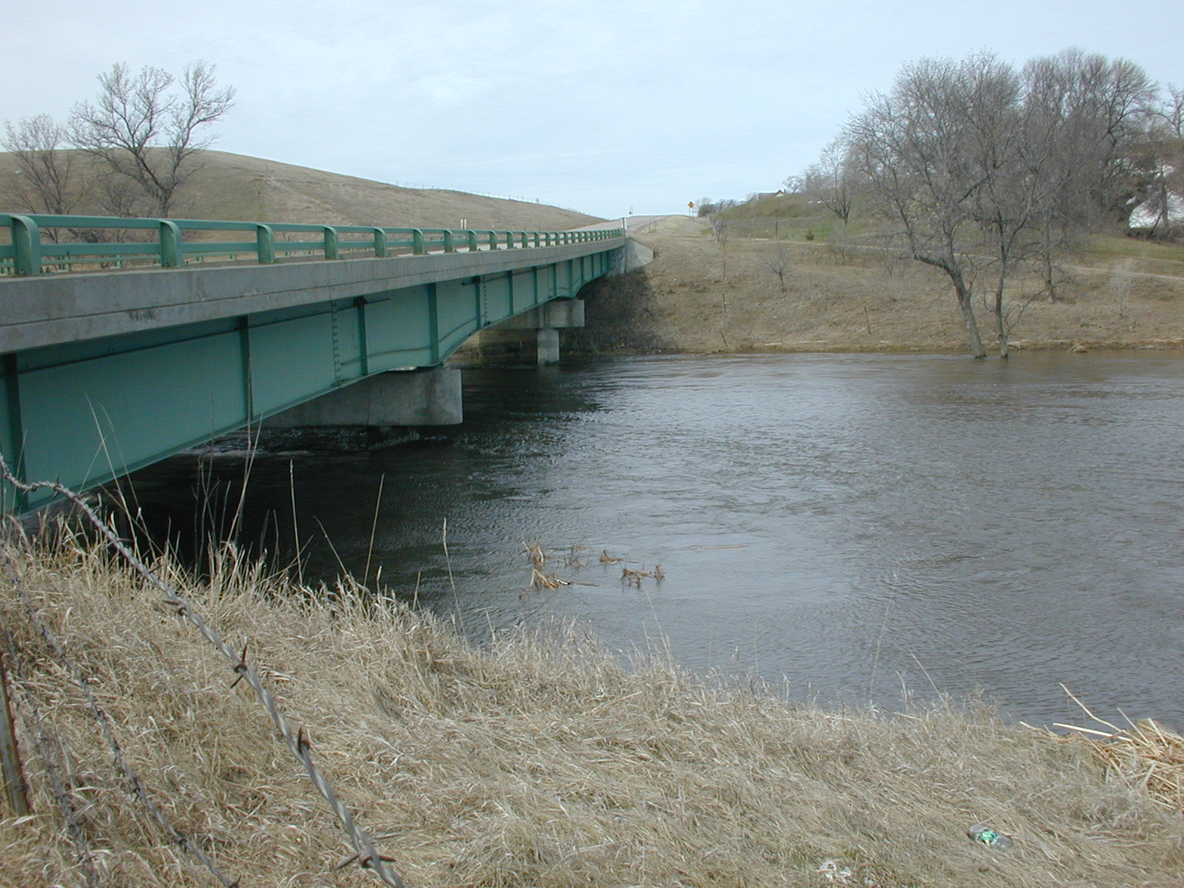
Site Problems
Notes:
This is an example of a fairly good bridge measurement site. Ask what might some problems be at this site? Assuming this is the down stream side of the bridge, at the right edge weeds/tall grass can be seen coming out of the water, so depth may be a problem. Also, if there are lots of submerged vegetation, you may have a bottom tracking problem.

Slide 4
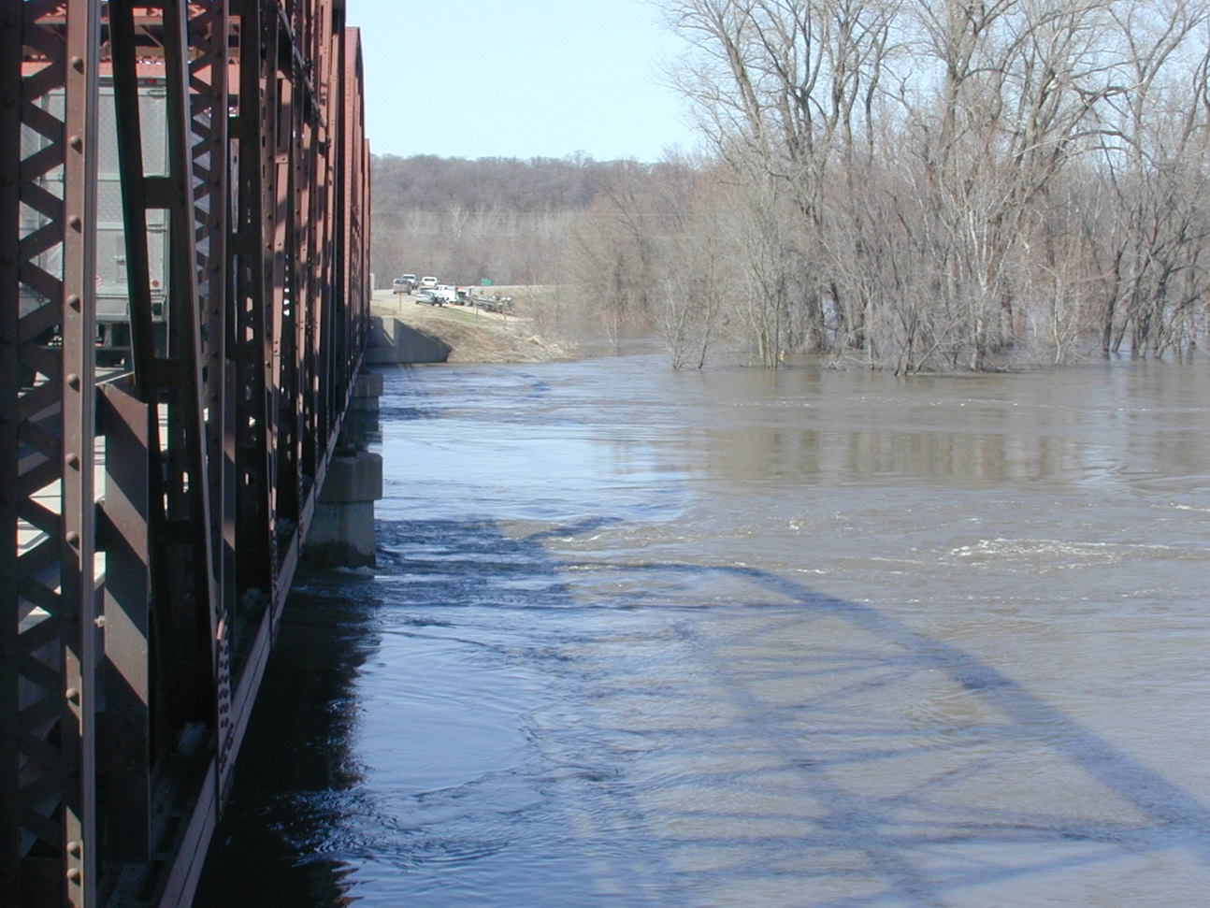
Site Problems
Complex currents, turbulence, and reverse flows around bridges can result in a poor measurement section
Bridges with truss structures make it difficult to tow a boat across the channel.
Notes:
Lots of turbulence downstream of piers. The left edge actually has reverse flow. Truss bridge makes it very difficult to tow the boat across the channel.

Slide 5

Site Problems
Notes:
Lots of turbulence downstream of piers. The left edge actually has reverse flow. Truss bridge makes it very difficult to tow the boat across the channel.

Slide 6
ADCP Deployment
Tethered Boats
Tethered from Manned Boats
Cableways
Remote control Boats
Vehicle Mounted Crane

Slide 7
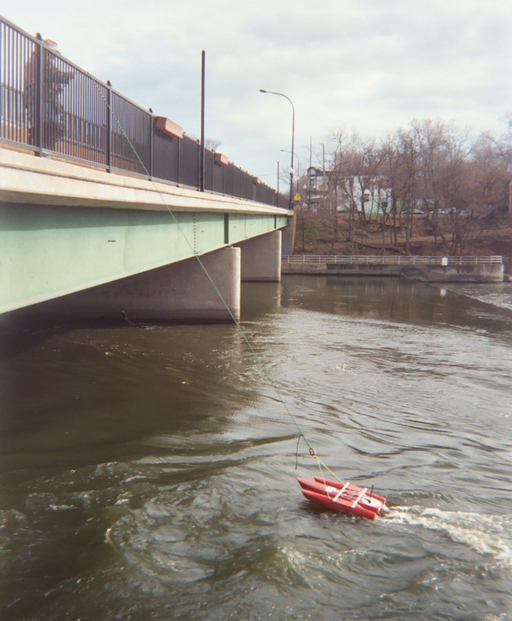
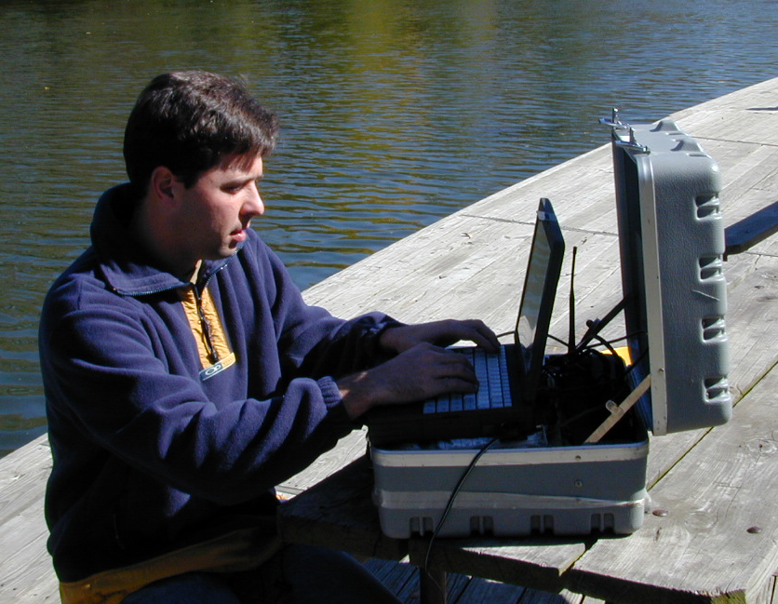
Streamflow Measurement – Tethered Boats
Notes:
This slide shows a tethered boat being used to make a discharge measurement. With tethered boats, ADCP data is radioed from the ADCP on the boat to the ADCP operator who is located somewhere on the shore (see photo on the left). Tethered boats measurements require 2 people, one to operate, configure, and collect data from the ADCP, and the other to operate the boat by means of a tether. This person can set up anywhere as long as he/she is within range of the radio modems. The other person tows the tethered boat back and forth across the measurement section (photo on the right).
What potential problems do you observe in the measurement being made on the right?

Slide 8
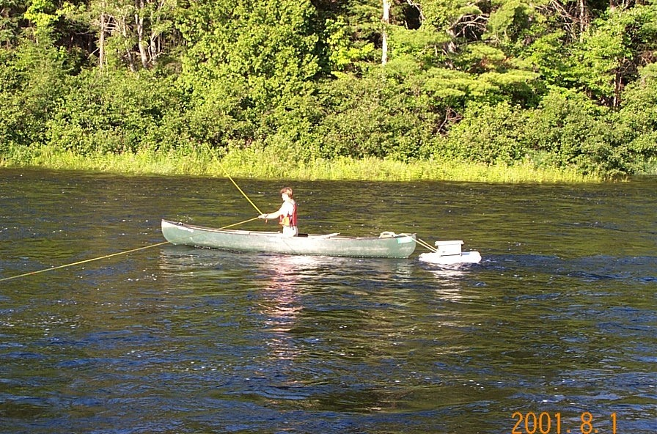
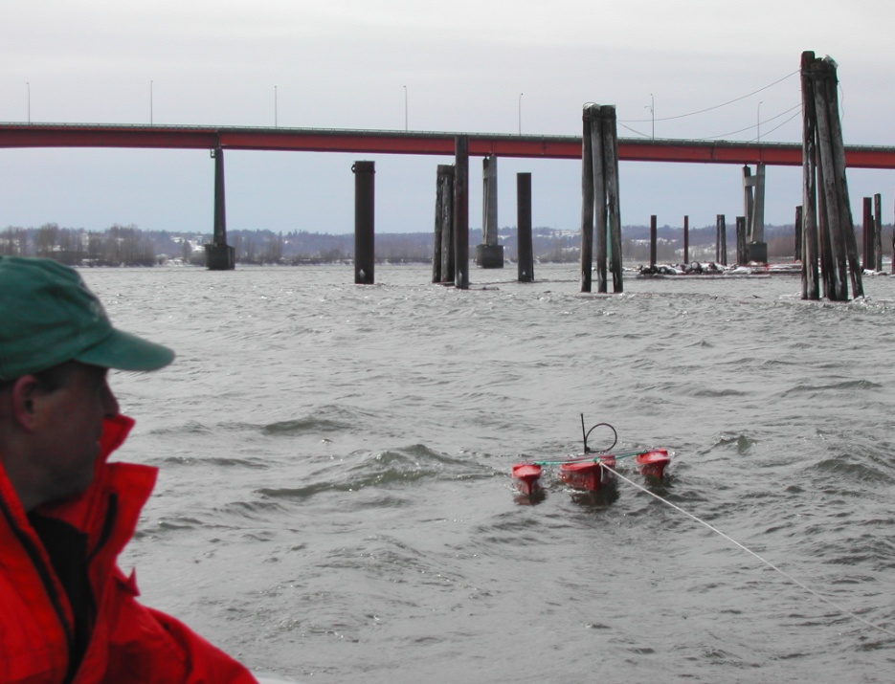
Tethered from a Manned Boat
Notes:
Gets ADCP away from biases and other problems caused by the manned boat (metal/compass problems, flow disturbance/boat wake problems, dampens effects of “jerky” boat pilot, less pitch and roll than on manned boat when in still water)
Potential problems…
On large rivers where there is a lot of “chop” a large stable manned boat may have less pitch/roll than a small tethered boat.
Be aware of any possible flow disturbances caused by the manned boat near the tethered boat.
Depending on the method of deployment, it may harder to control boat that are tethered to manned boats.

Slide 9
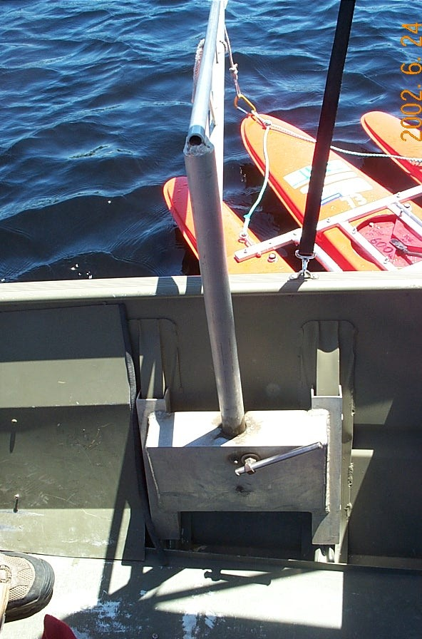
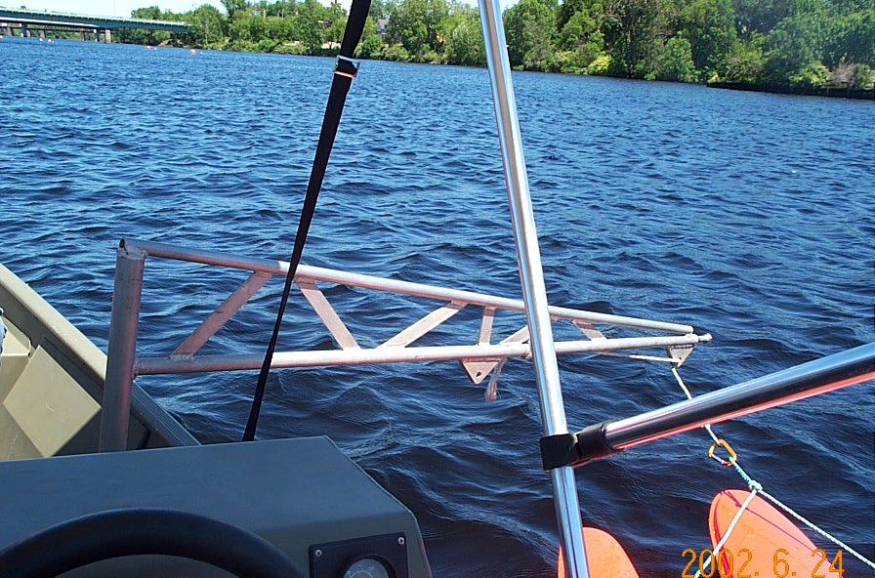
Boat Mounted
Tethered Platform Deployments
Notes:
Boom mount to use tethered boat from a manned boat.
The boom moves the tethered boat away from flow disturbance of the manned boat and also isolated tethered boat from the pitch and roll of the manned boat. Because the tethered boat tends to always have the same payload, changes in transducer draft are much less of a concern.

Slide 10
Tethered Boat Measurements
Advantages:
  Less time on bridges compared to conventional bridge measurements , reducing exposure to traffic hazards
  Fast and easy deployment
  Can often be used where manned boats cannot be launched
  Can move more slowly across the river with more control than a manned boat, depending on site conditions
Notes:
Advantages:
Generally safer than using manned boats
Can be deployed easier and faster than manned boats
Can often be used where manned boats cannot be launched
Can be moved across the river more slowly and with more control than a manned boat; improving ADCP measurement quality at some sites.
Advantages of using tethered boats for ADCP measurements:
When compared to convention price AA bridge measurements, tethered boat ADCP measurements made from bridges require less time spent on bridges. This reduces the time people are exposed to traffic hazards.
Tethered boats can be quickly deployed from bridges without long setup time.
For sites where there is not a boat ramp for launching manned boats, tethered boats can be lowered from bridges, or used from cableways.
In many situations, especially in smaller streams, it can be easier to make a more controlled measurement when using a tethered boat compared to a large manned boat.

Slide 11
Tethered Boat Measurements
Limitations:
  Generally confined to the downstream side, with limited ability to change measurement sections by changing rope length
  Turbulence from bridge piers and abutments can degrade measurement quality
Notes:
Limitations:
Measurement site selection is limited- usually confined to the downstream side of bridges and from cableways
The quality of measurements made on the downstream side of bridges can be degraded by turbulence from bridge piers
Very difficult to use GPS/depth sounder from a tethered platform when needed for moving bed conditions
Limitations of tethered boat measurements:
Measurement-site selection is limited. Use of a thetered boat usually is confined to the downstream side of bridges and to cableways. The ablity to change measurement sections from these structures is limited to changes in rope length to vary the doantream distance of the boat.
The quality of discharge measurement made on the downtream side of bridges can be degraded by turbulence from bridge piers and abutments.
If GPS and/or depth sounder are require they each require another set of radio modems or special multi-channel radio modems.

Slide 12
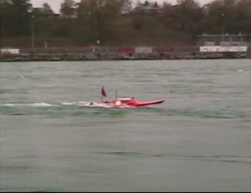
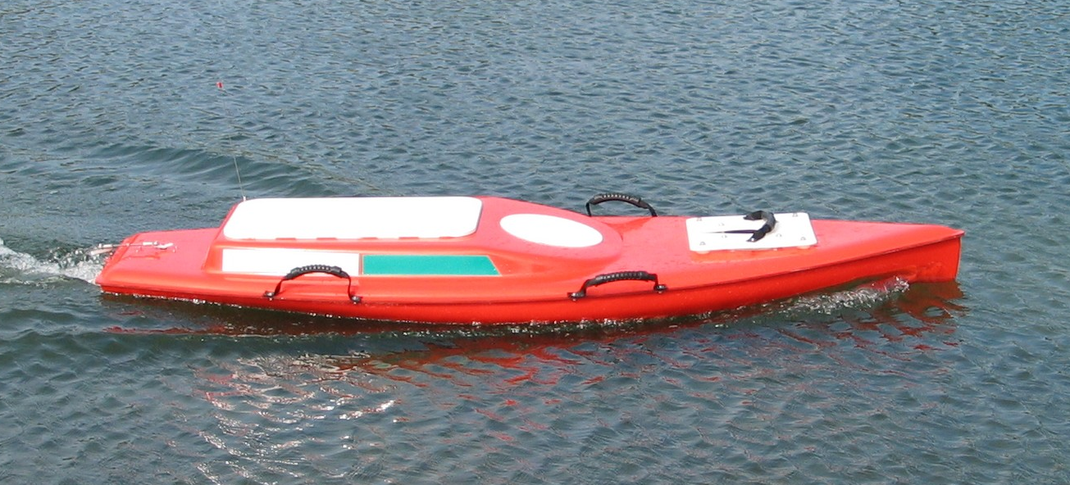
Streamflow Measurement –
Remote Control Boats
Notes:
In addition to using manned and tethered boats for ADCP measurements, the USGS has invested into the development of remote-controlled (RC) boats. This remote control boat can be used where use of a manned boat is difficult or unsafe, such as insufficient clearance under bridges. It could be that in the future, as we perfect the development of RC boats and their control systems, many of our measurements will be made with RC boats. This particular boat was built under contract with OceanSciences Group. The video clip in the upper right shows an earlier prototype of this RC boat.

Slide 13
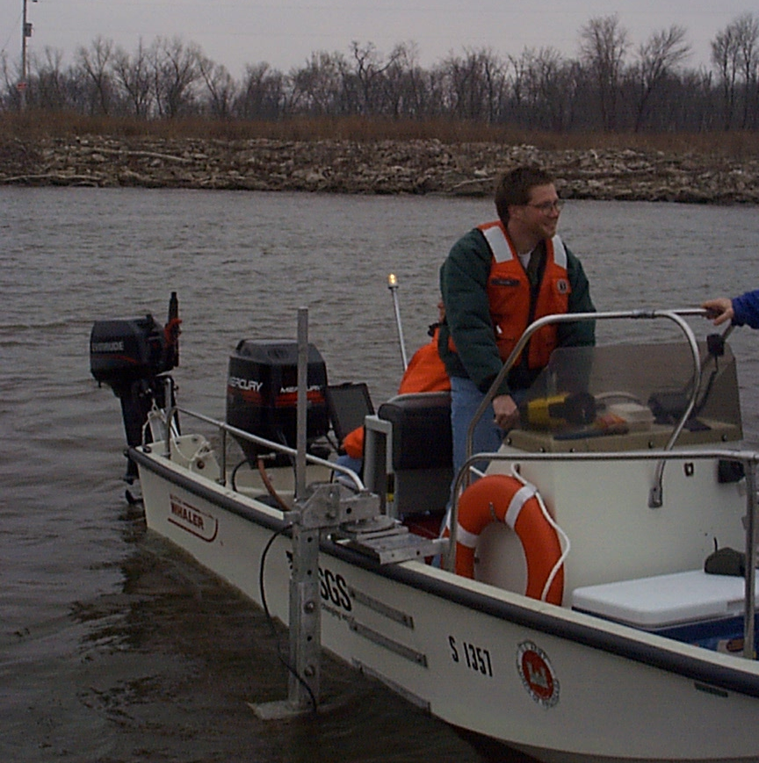
Streamflow Measurement – Manned boat
Notes:
This slide shows the use of a manned boat to make an ADCP measurement. Notice that this boat is equipped with a kicker motor in addition to the main motor for the boat.

Slide 14
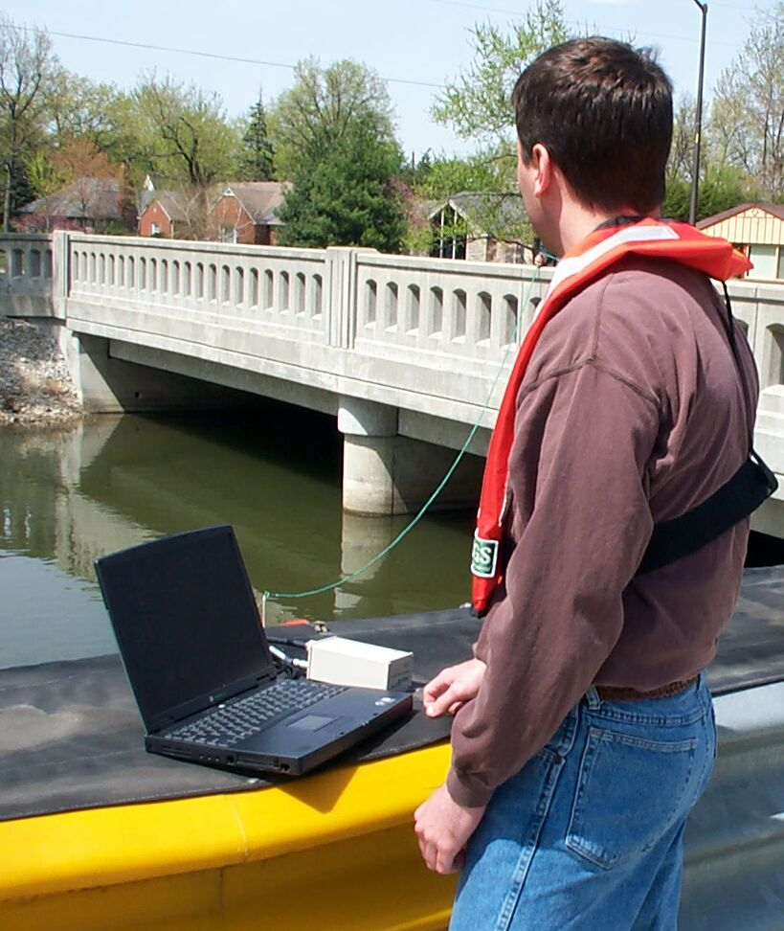
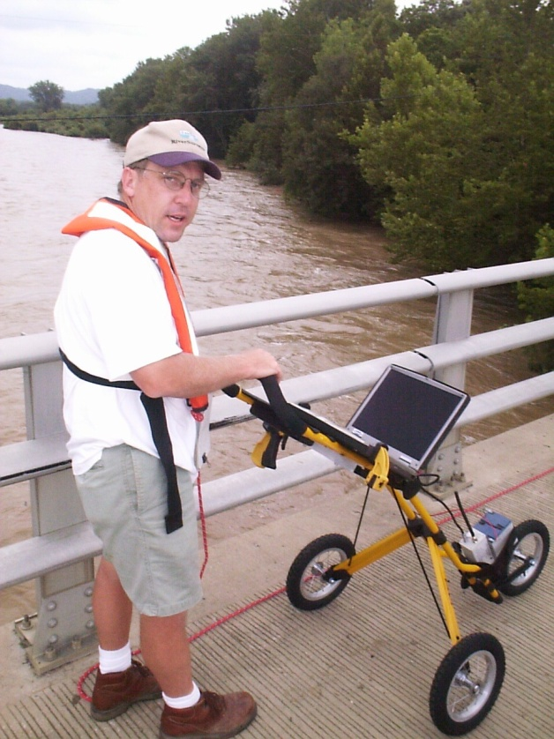
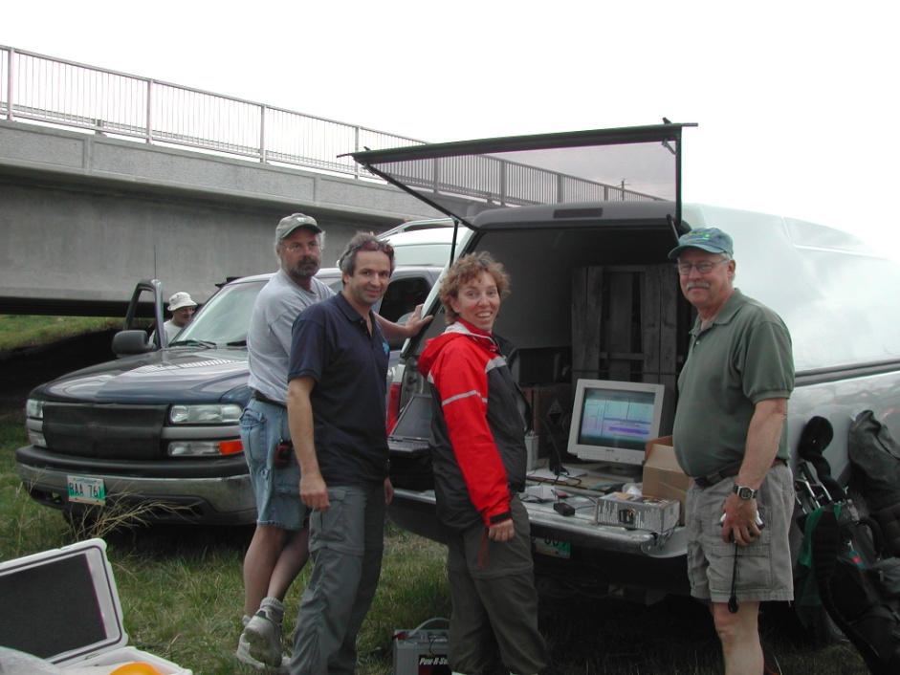
Computer
Operator
Notes:
Usually the Computer operator sits on the shore while another person pulls the boat back and forth across the stream.
Some people have made one man tethered ADCP measurement by taking the laptop with them while pulling the tethered boat across the river.
Picture on left shows laptop attached to a golf cart, with battery and radio modem.
Picture on top right shows normal bank setup.
Picture on bottom right shows the Canadians using a full size CRT monitor in the back of the truck.

Slide 15
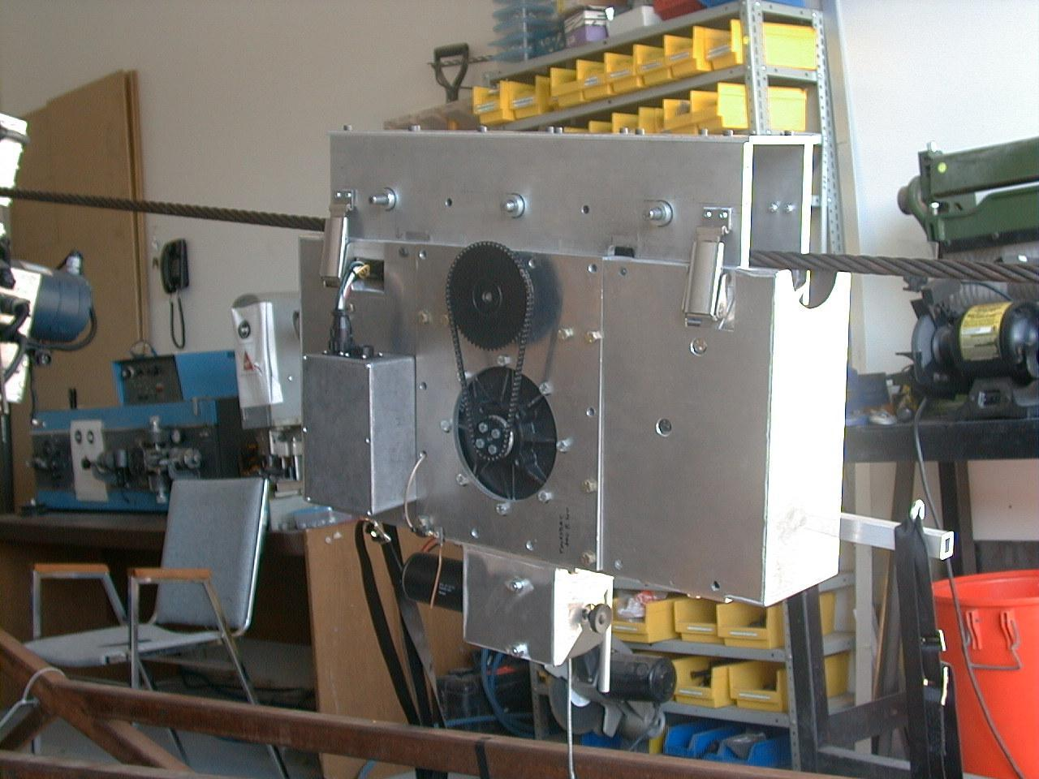
Cableway Measurements
Notes:
Canadian remote control cable way.

Slide 16
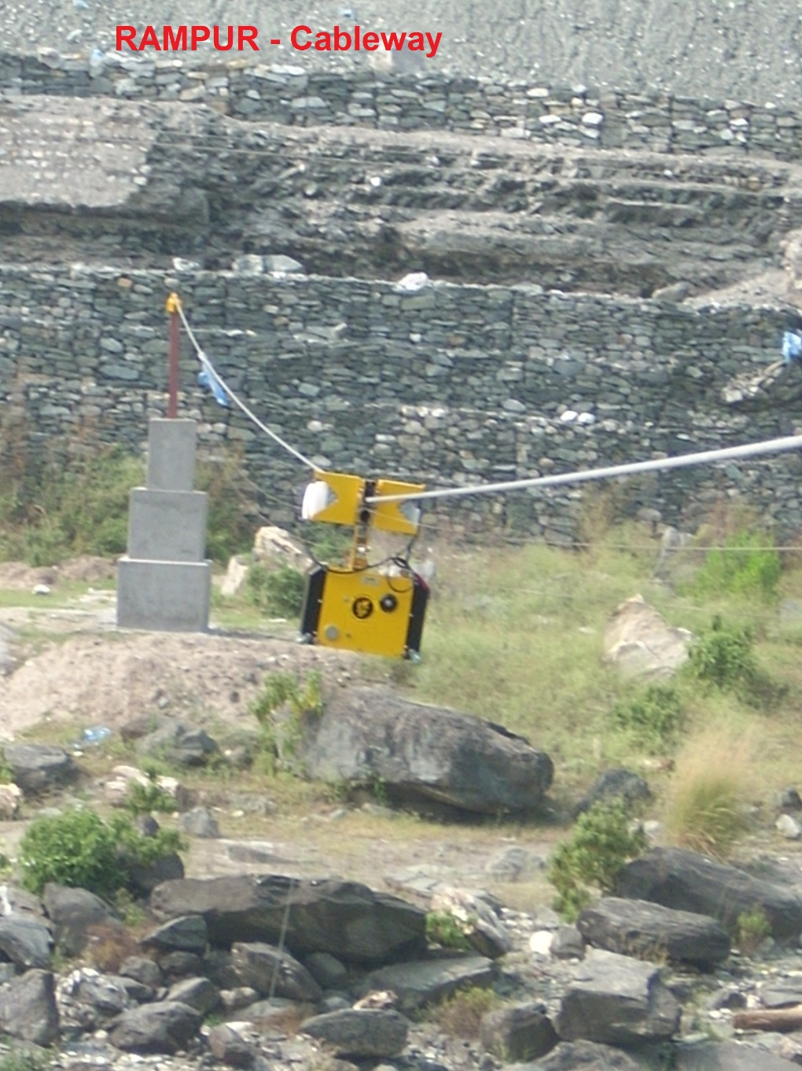
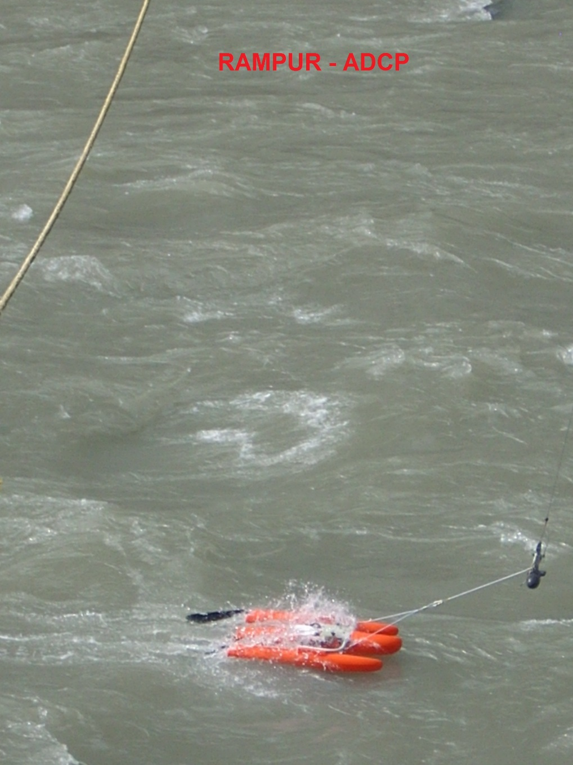
Cableway - BBMB

Slide 17
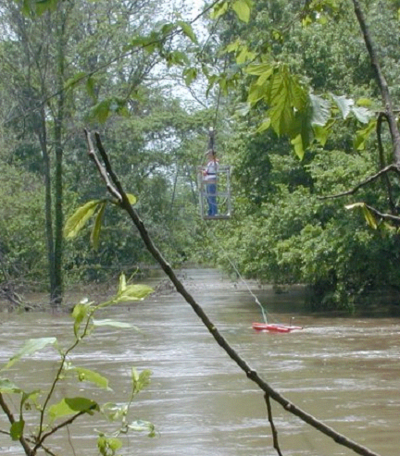
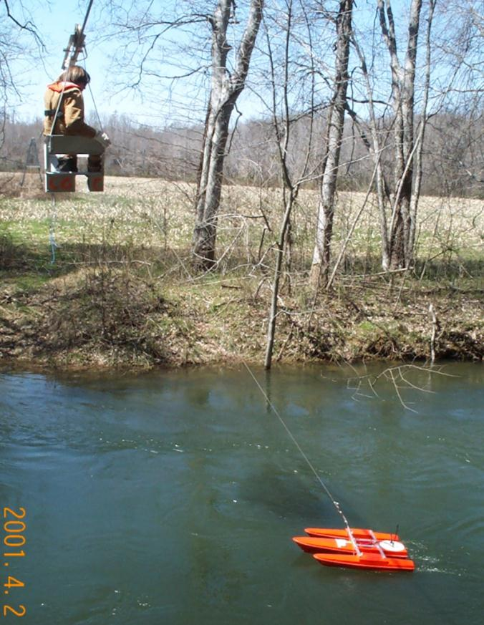
Cableway Measurements

Slide 18
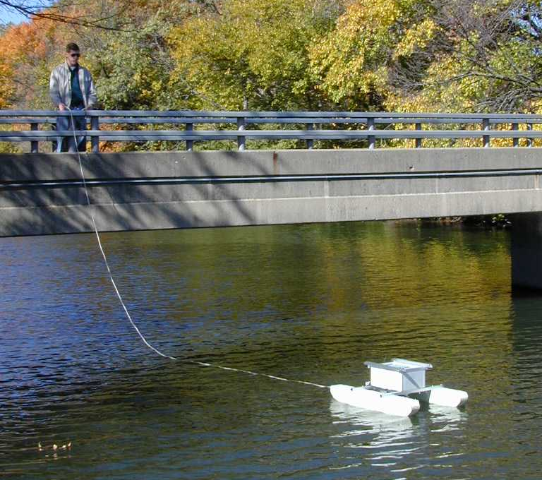
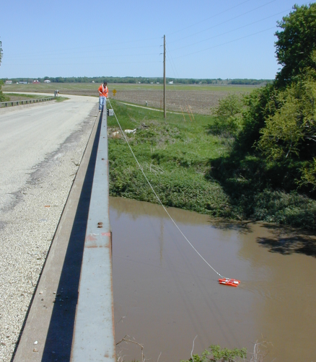
Bridge Measurements
Notes:
Most common method is from the downstream side of a bridge. What problems might you encounter on the downstream side of bridges? Turbulence from bridge piers, still might have traffic safety issues.

Slide 19
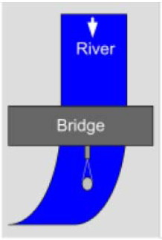
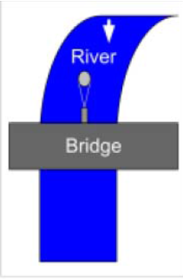
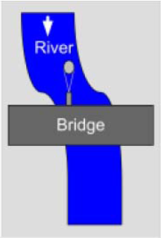
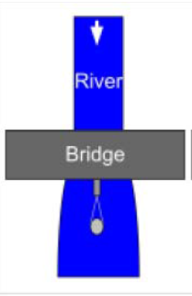
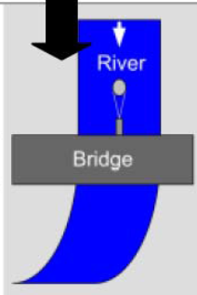
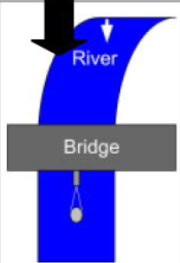
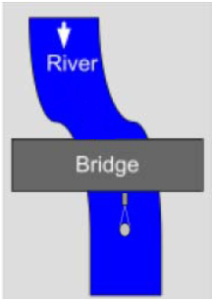
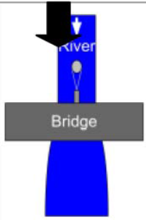

Slide 20
Vehicle Mounted Crane

Slide 21
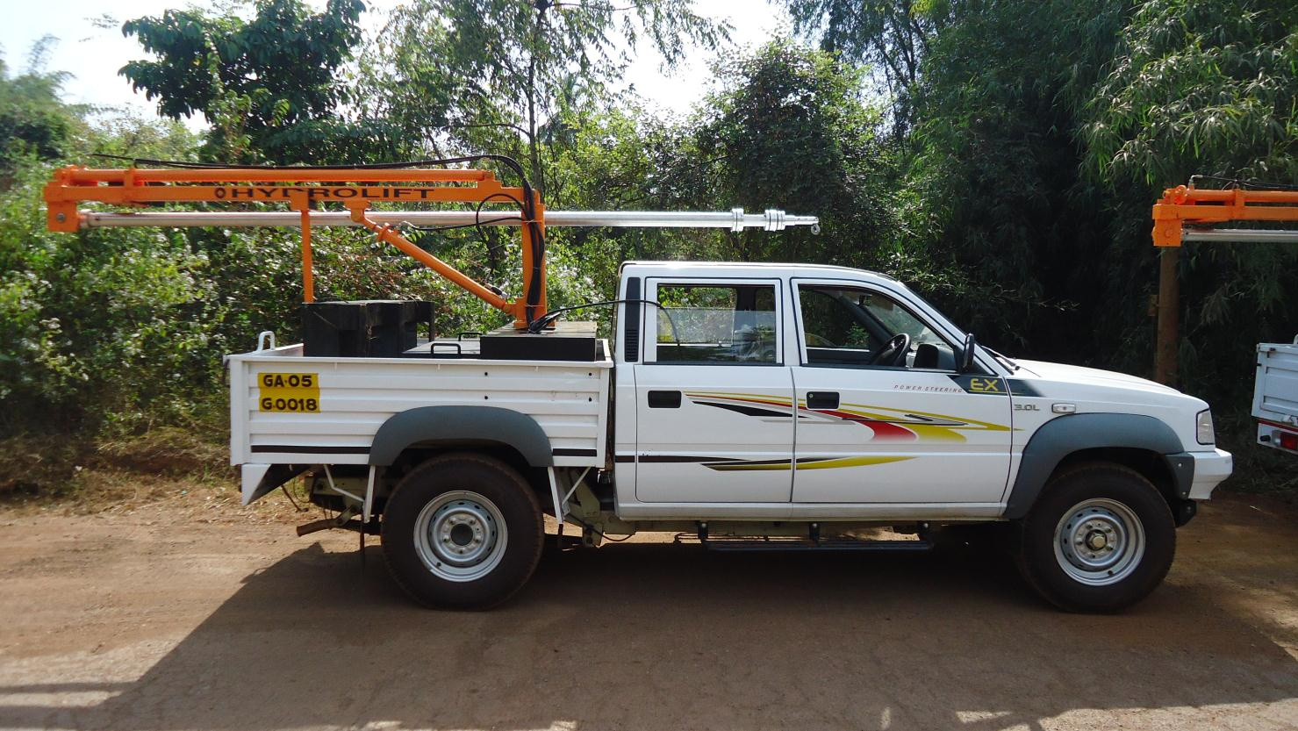

Slide 22
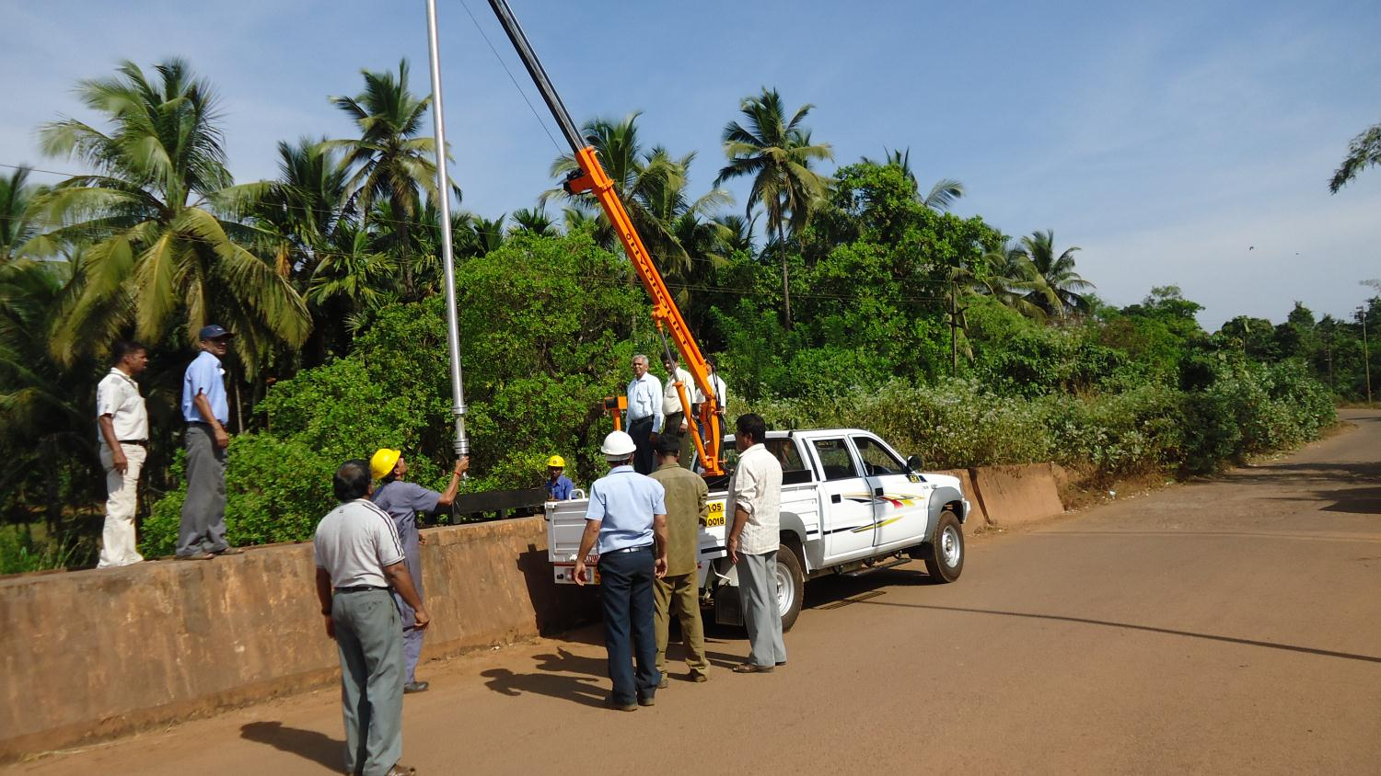

Slide 23
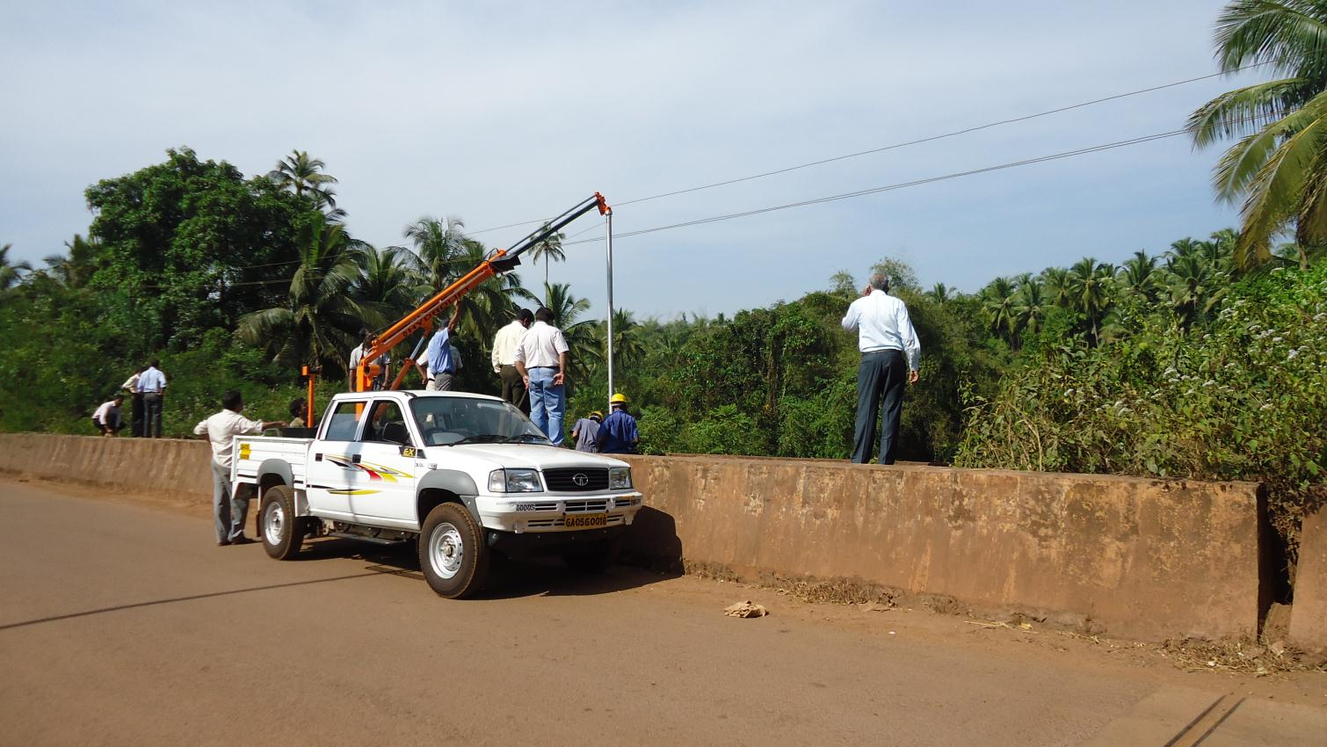

Slide 24
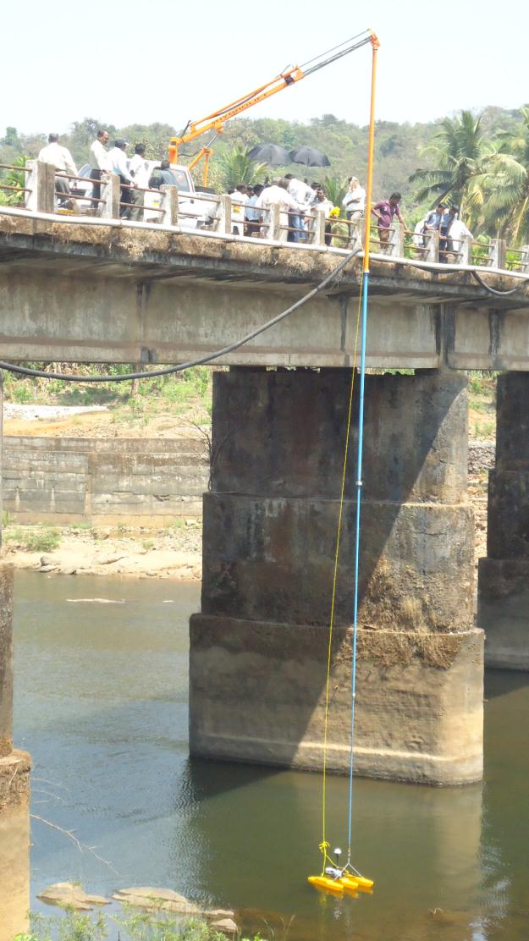
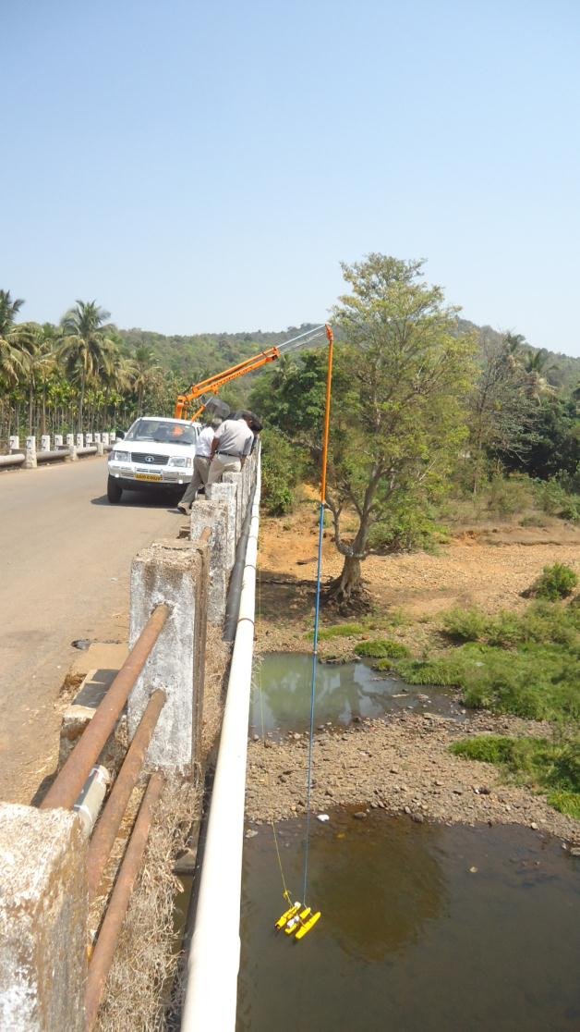

Slide 25
Computer
Operator
Notes:
Usually the Computer operator sits on the shore while another person pulls the boat back and forth across the stream.
Some people have made one man tethered ADCP measurement by taking the laptop with them while pulling the tethered boat across the river.
Picture on left shows laptop attached to a golf cart, with battery and radio modem.
Picture on top right shows normal bank setup.
Picture on bottom right shows the Canadians using a full size CRT monitor in the back of the truck.

